Slide 1
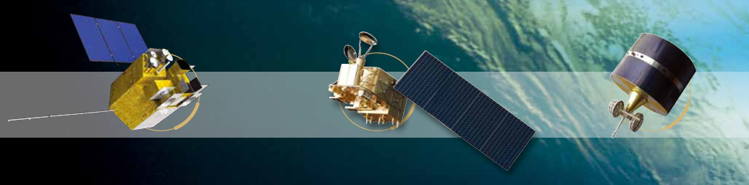

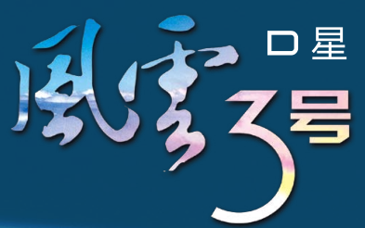
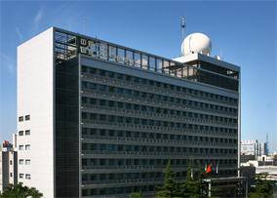


Calibration and Validation of FY-3D Optical Sensors MERSI-II and HIRAS
Xiuqing Hu,
Na Xu, Chenli Qi, Hanlie Xu, Chunqiang Wu，
Lin Chen, Ling Wang, Ronghua Wu, Ling Sun, Peng Zhang
National Satellite Meteorological Center,
China Meteorological Administration
(NSMC/CMA)
2019 CSPP June 25-27, Chengdu, China

Slide 2
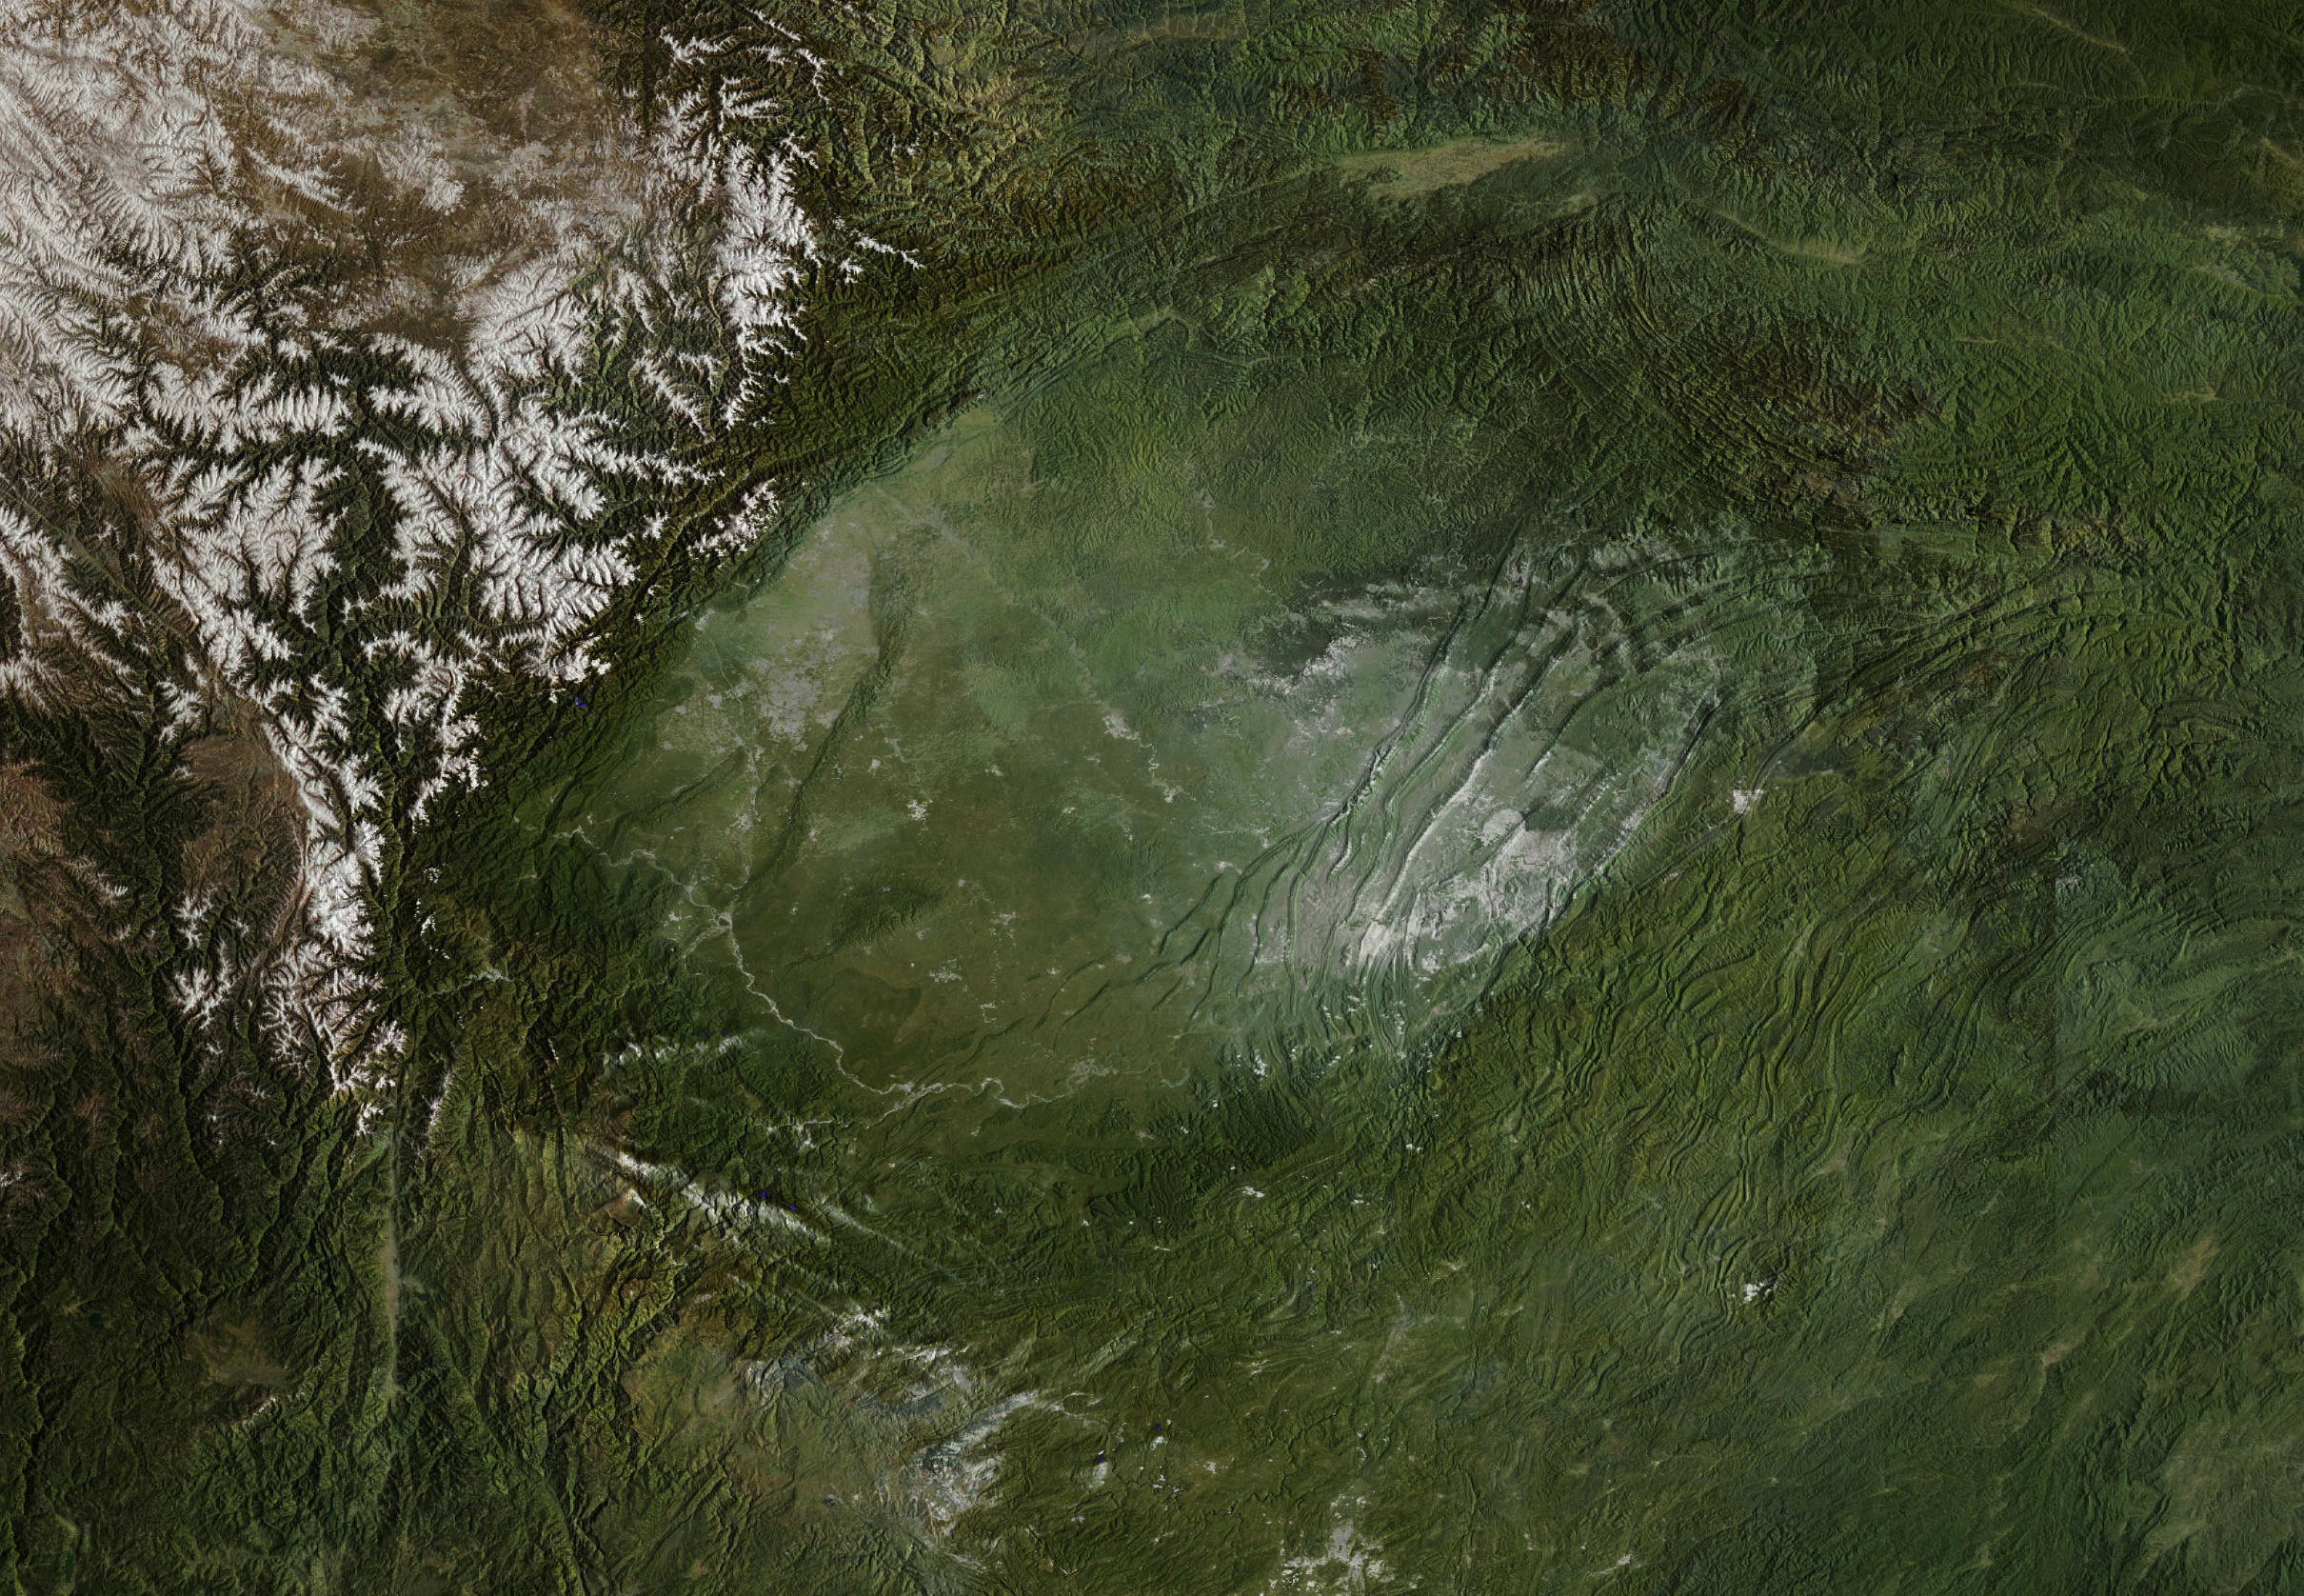
Outline
Overview of FY-3D optical sensors
MERSI-II Cal/Val
HIRAS Cal/Val
Mutual Evaluation of MERSI-II and HIRAS
MERSI-II Products Demonstration
Summary

Slide 3

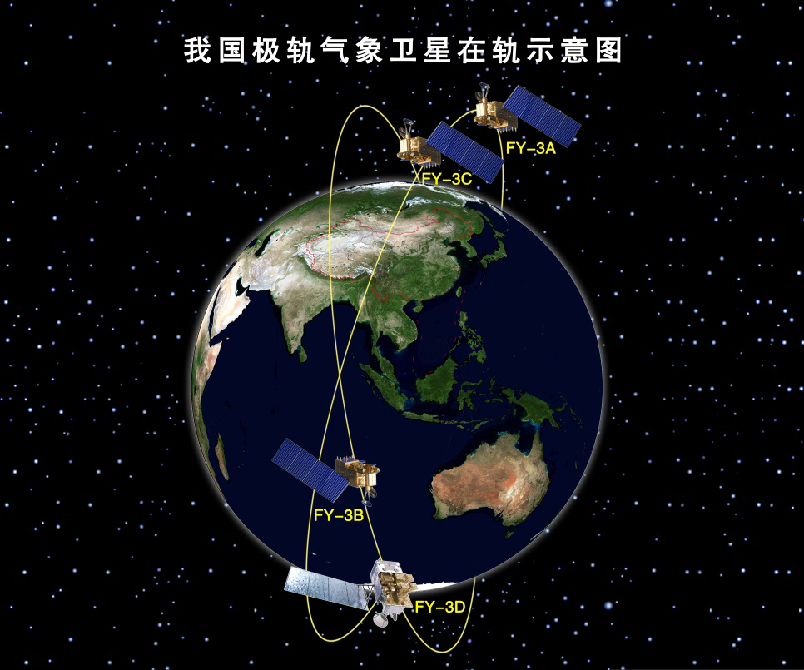
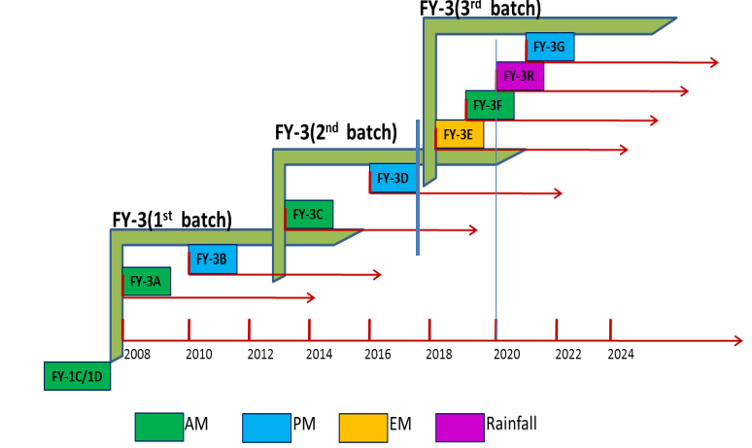
Background of FY-3X serial satellite
FY-3 is the Chinese second generation LEO meteorological satellite.
Four Satellites has already been on orbit and four more satellite will be lunched.
2008.05.27 | FY-3A | AM
2010.11.05 | FY-3B | PM
2013.09.23 | FY-3C | AM
2017.11.15 | FY-3D | PM

Slide 4
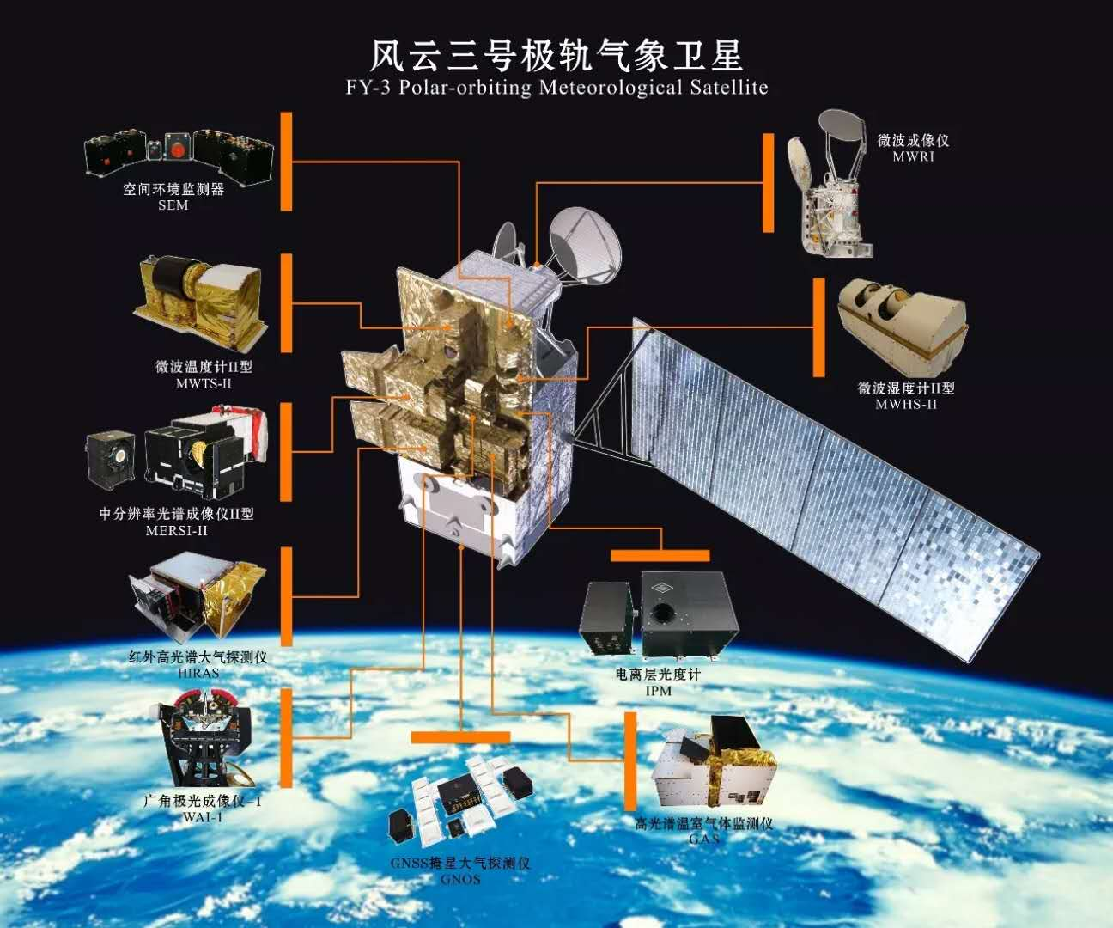
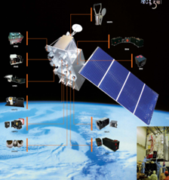
FY-3D Instrument configuration
-- Launched on 15, Nov. 2017 and commissioning almost finished
FY-3D
10 instruments on board FY-3D:
5 Successive instruments:
MWTS-II: Microwave Temperature sounder
MWHS-II: Microwave Humidity sounder
MWRI: Microwave Radiation Imager
GNOS: Global Navigation Occultation Sounder
SEM: Space Environment Monitor
2 Improved instruments：
MERSI-II：Improved from MERSI
HIRAS: Upgraded from filter-type sounder IRAS
3 New Instruments:
GAS: Greenhouse gases Absorption Spectrometer
WAI: Wide-angle Aurora Imager
IPM: Ionospheric Photometer
FY-3A/B/C

Slide 5
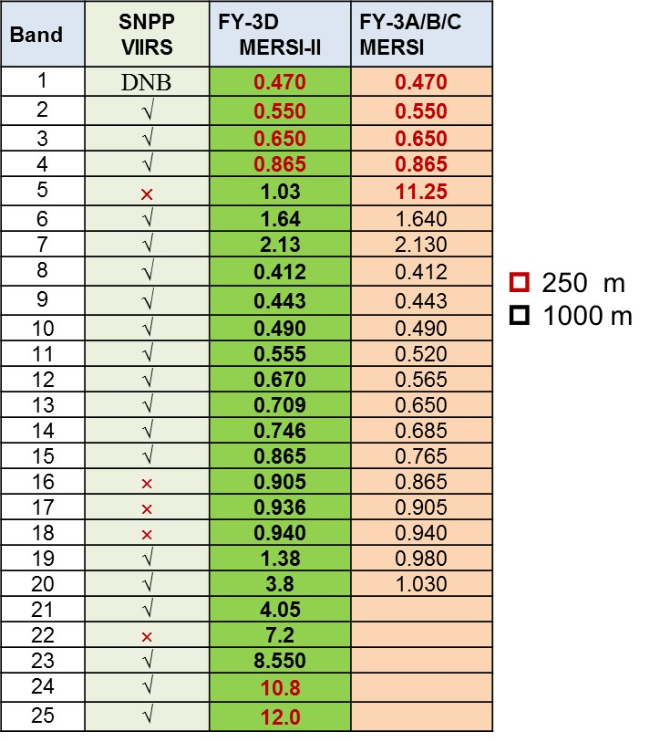
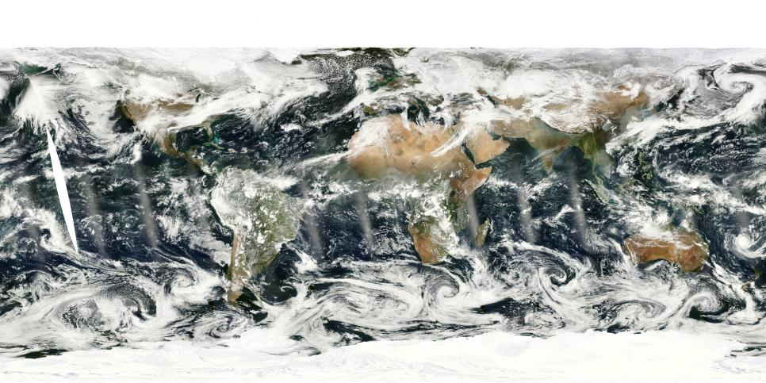
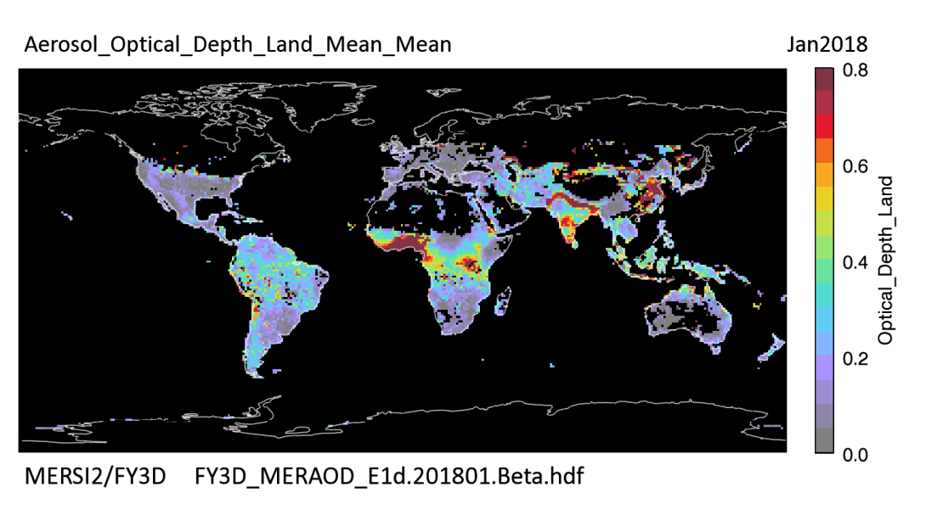
Imager of FY-3D: MERSI→MERSI-II
Continuity and Evolution
MERSI-II Improvement:
  Cover all bands in FY-3A/B/C MERSI
  Five more IR bands with 2 split windows with 250m spatial resolution
  Add Circurrus cloud band 1.38um
  Water vapor bands In NIR and 7.2um
  Higher accuracy using onboard calibrator
  Lunar Calibration capability
MERSI-II global Mosaic image
MERSI-II global AOD over land

Slide 6
MERSI-II improvements from MERSI
More Baffle to decrease straylight contamination: have been installed on the head of the instrument to further prevent contamination from solar illumination.
OBCBB structure improvements to enhance emissivity and temperature uniformity, new capability on warm up and cool down (WUCD)
New capability for Moon Observation Maneuver: By changing the scan timing sequence, MERSI II has a moon observation mode, which can achieve the initiative moon observation and calibration ability.
RSB VOC improvements to reduce self-degaradation: To minimize SIS degradation and its associated effects due to solar exposure, a shutter door is mounted on the solar incident light cone and is kept closed except during solar calibration events. The spectra of the standard trap detectors are also adjusted to better characterize changes in MERIS RSBs.
Notes:
Overall, many design improvements have been applied in MERSI II, laying the foundation for better on-orbit performance and measurement.
more Baffle to decrease straylight contamination: have been installed on the head of the instrument to further prevent contamination from solar illumination.
structure improvements and WUCD capability on OBCBB:The structure of the MERSI II OBCBB is optimized to enhance emissivity and temperature uniformity. The thickness has been increased from 8 mm to 25 mm, and the V-groove included angle has decreased from 45° to 30°, which increases the effective emissivity from approximately 0.94 to >0.97. The MERSI II OBCBB, which is normally controlled at a fixed temperature, has been redesigned with the capability to warm up and cool down (WUCD) via several heating elements.
New capability for Moon Observation Maneuver: By changing the scan timing sequence, MERSI II has a moon observation mode, which can achieve the initiative moon observation and calibration ability.
VOC improvements to reduce self-degaradaiotn :To minimize SIS degradation and its associated effects due to solar exposure, a shutter door is mounted on the solar incident light cone and is kept closed except during solar calibration events. The spectra of the standard trap detectors are also adjusted to better characterize changes in MERIS RSBs.

Slide 7
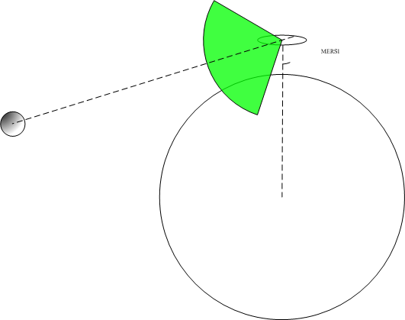
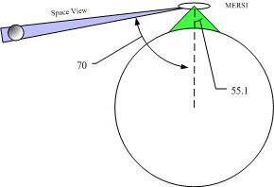
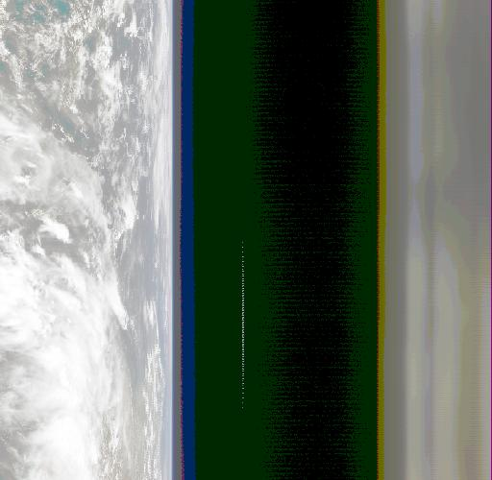
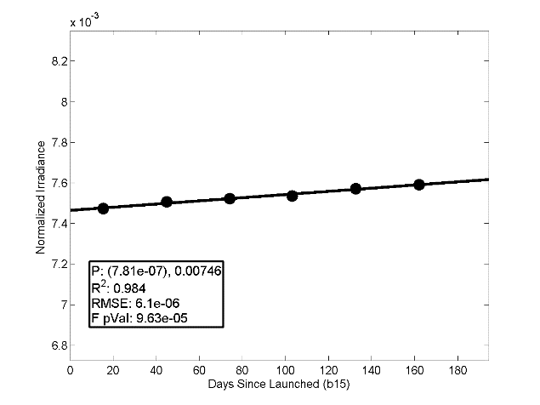
Moon view and calibration
Unschedule
Schedule
Interband Calibration
Absolute Calibration
Degradation monitoring
Notes:
Moon calibration
mainly based on unscheduled observation monthly
absolute and interband calibration
degradation monitoring

Slide 8
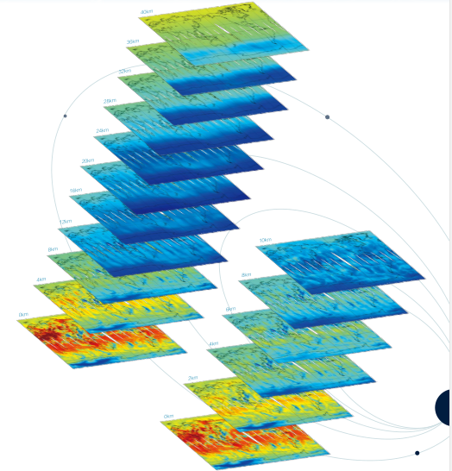
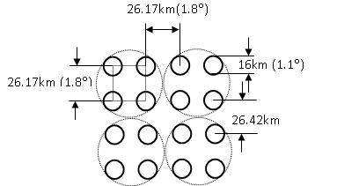
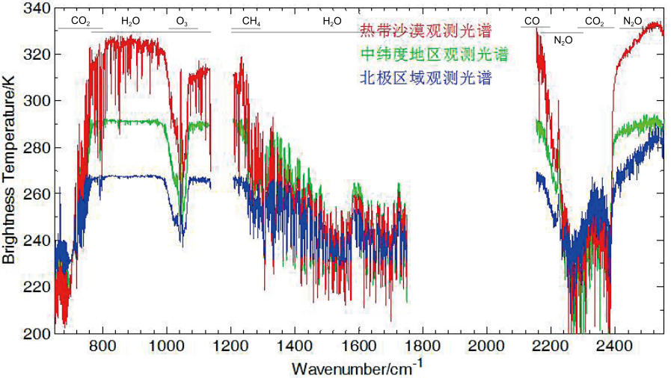
IR Hyperspectral HIRAS
HIRAS is a great improvement to Chinese satellite infrared atmospheric sounding system
Band | Spectral range (cm-1) | Resolution (cm-1) | NEΔT @250K | chs
Longwave | 650 *– 1136 （15.38 μm-8.8 μm） | 0.625 | 0.15K | 778
Midwave1 | 1210 – 1750 （8.26μm-5.71 μm） | 1.25 | 0.1K | 433
Midwave2 | 2155-2550 （4.64μm-3.92 μm） | 2.5 | 0.3K | 159

Slide 9
FY-3D Commissioning and Operational Phase
15 November
2017
lunched successfully
31st June
2018
Complete the orbital check out
Complete summary and review of the orbit test
July
2018
Oct.
2018
August
2018
Turn into formal operation and data release
In-orbit delivery for trial operation

Slide 10
MERSI/HIRAS Cal/Val using GSICS
Spectral calibration, radiometric calibration and geolocation accuracy of FY-3D MERSI-II and HIRAS including the was conducted using GSICS platform at CMA GSICS research processing center (GPRC). The GSICS-consensus reference instruments IASI, CrIS, MODIS and VIIRS are used to evaluate the radiometric accuracy of MERSI-II and HIRAS.
Accurate collocation and inter-comparison between MERSI-II and HIRAS at the same satellite platform FY-3D gave us several important information of their performance, especially the knowledge of HIRAS subpixel geolocation shift.
Based on the above GSICS evaluation, mechanism behind radiometric calibration bias of MERSI-II and HIRAS also were found including the non-linearity, polarization effect and other parameters of the instruments. These parameters were updated several times based on comprehensive assessment and iterative validation during the commissioning test.

Slide 11
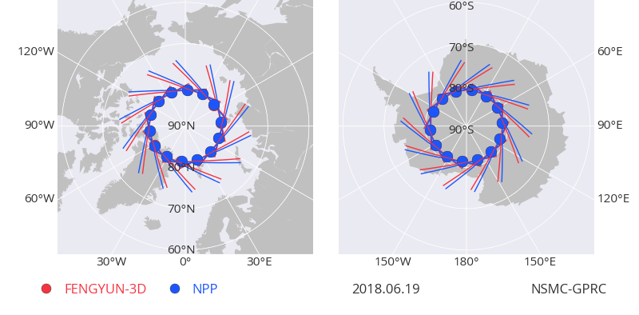
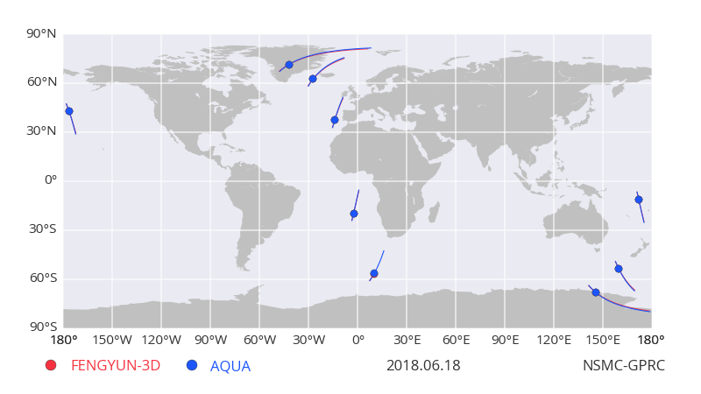
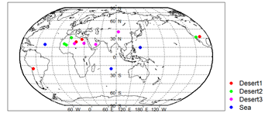
CMA GSICS Platform
All kinds of data are collected to perform Wide Dynamic calibration based on CMA GSICS GPRC
SNO
SNOx
Global deserts

Slide 12
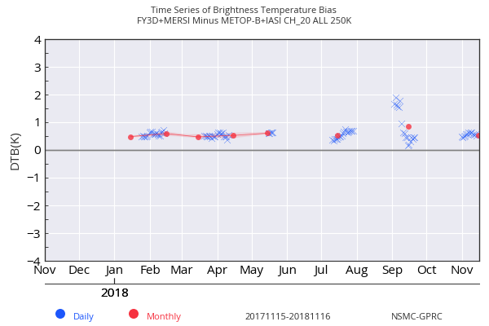
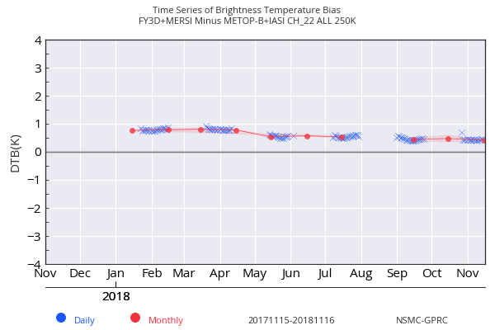
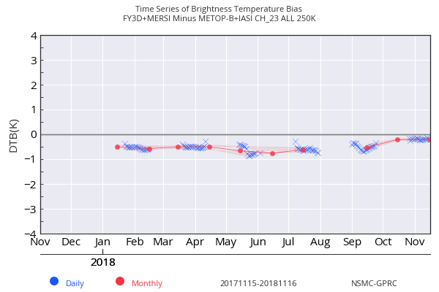
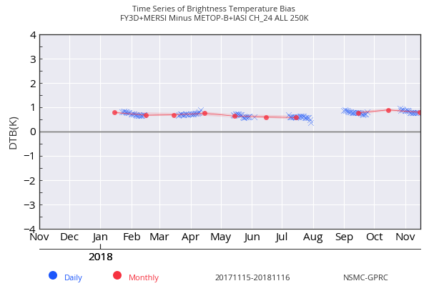
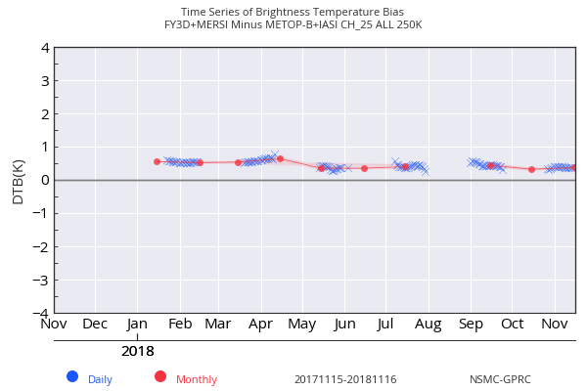
MERSI-II TEB Validation using SNO IASI and CrIS
IR calibration bias and stability monitoring Using Metop-B IASI reference
TB Bias@250K is about 0.5K~1K based on prelaunch BB emissivity and nonlinear parameter
Band 20
Band 22
Band 23
Band 24
Band 25

Slide 13
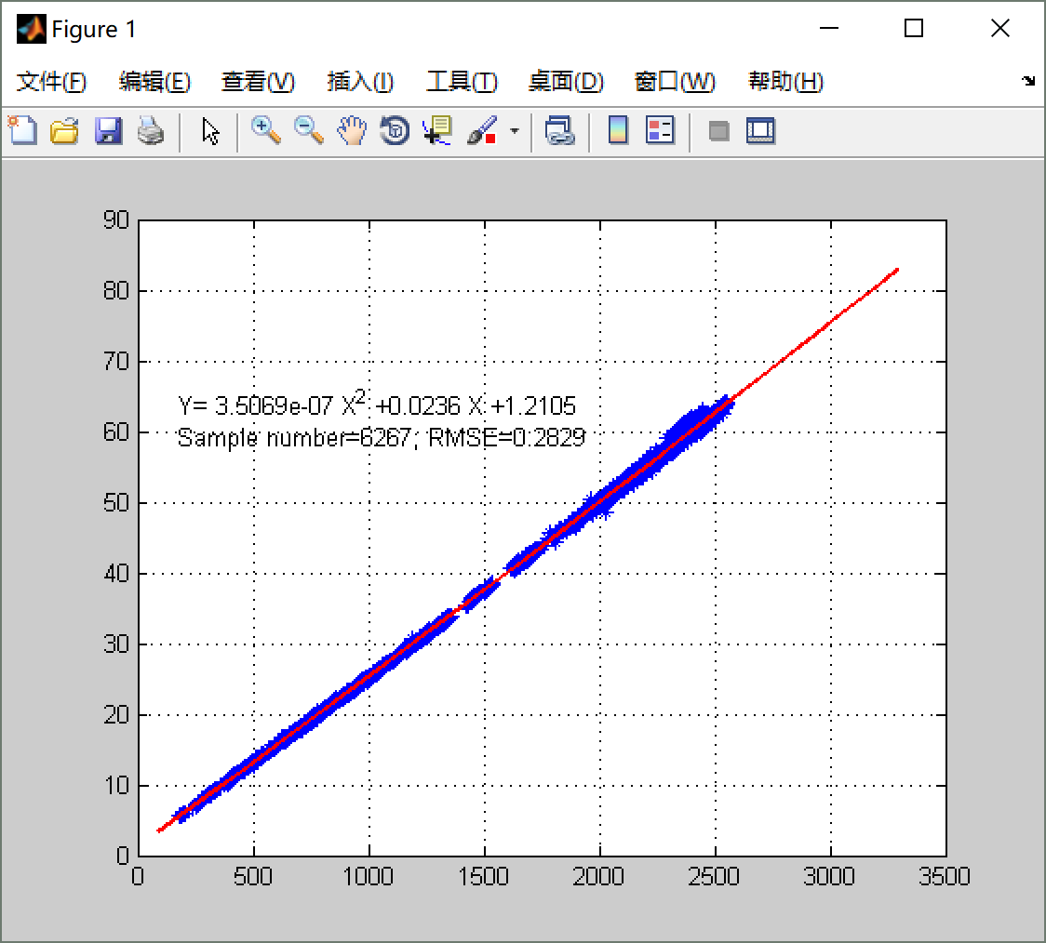
MERSI TEBs calibration
update procedure
Find the calibration bias mechanism and Update the calibration parameters based on the GSICS evaluation
8.5μm
SNO Samples collection
Evaluation calibration bias
Update the calibration model
Validation using new samples

Slide 14
TEB Calibration update based on GSICS Evaluation
MERSI-HIRAS Inter-comparison（April~Sep.,2019）
Old Model New Model

Slide 15
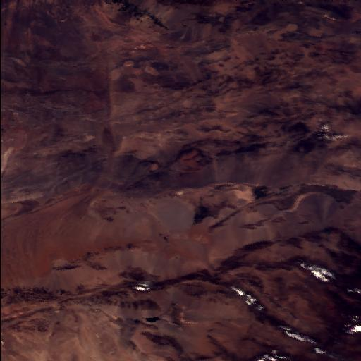
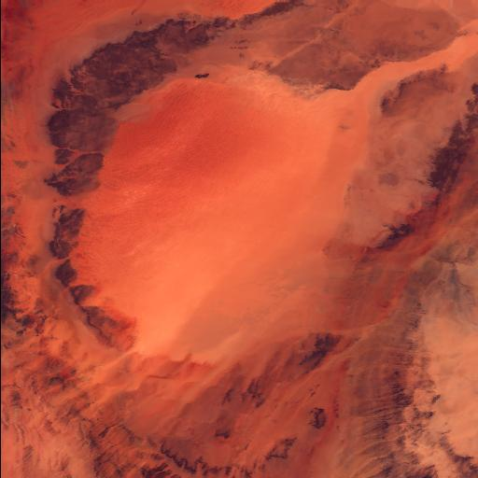
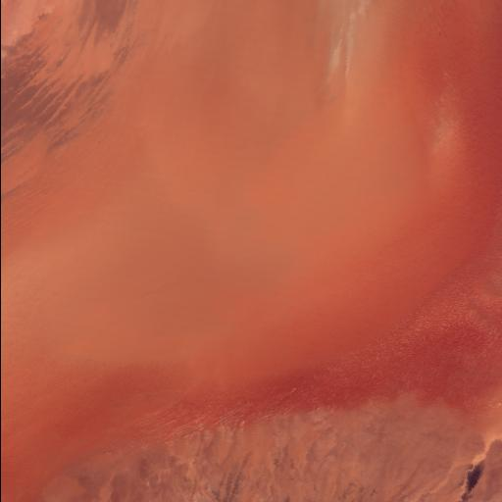
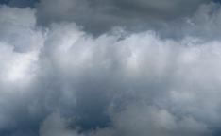
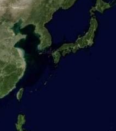
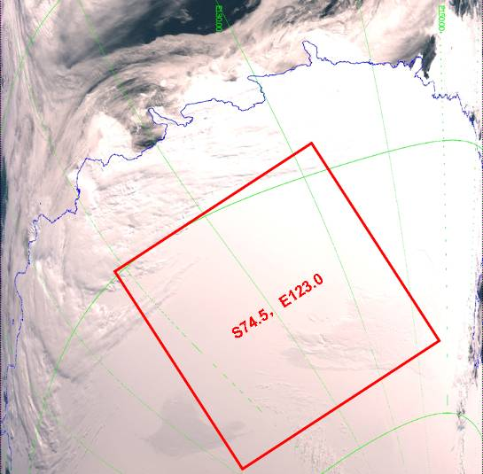
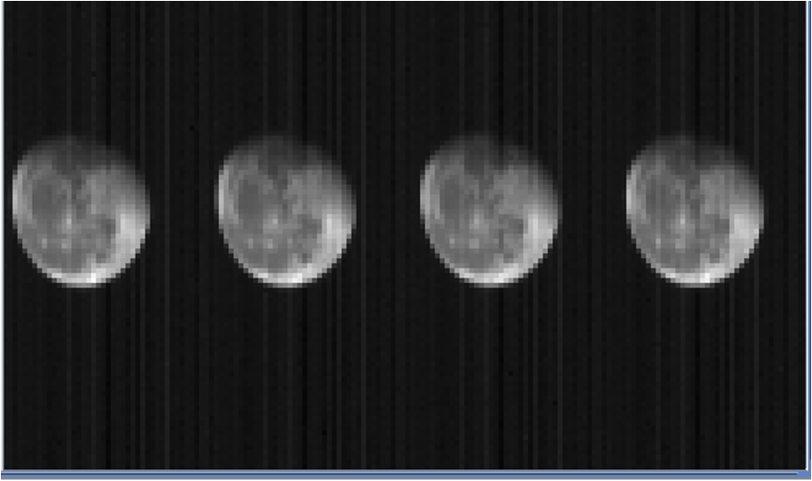
MERSI-II SRB Cal/Val methods
Reflectance Dynamic | Method | Comparison | Applicable channels of MERSI II
High（>80%） | DCC | Merit：high stability, providing high brightness information, better performance in the absorption channel Demerit：saturation in ocean channels | 1~7，16~19
Medium（<80%） | Multi-Site | Merit：multi-targets Demerit：seasonal variation affected by atmosphere and surface, unsuitable for absorption channels | 1~19
 | SNO_GOME | Merit： not rely on the atmosphere and surface observation, spectral differences can be ignored, providing medium reflectance targets for ocean channels; Demerit：Only suit for VIS channels | 1~3，8~15
 | SNO_MODIS | Merit：Do not rely on the atmosphere and surface observation Demerit：Need spectral correction | 1~18
 | SNO_VIIRS |  | 2~10、12、14、15
Low（<10%） | Moon | Merit：High stability Demerit：Accuracy depending on the moon model, low calibration frequency | 1~20
various targets
Dunhuang
(40.138°N, 94.32°E)
Libya1
(24.42°N, 13.35°E)
Arab2
(20.13°N, 50.96°E)
www.wps.cn 「 让PPT设计简单起来！」
Sea
15
DCC
DomeC
Moon

Slide 16
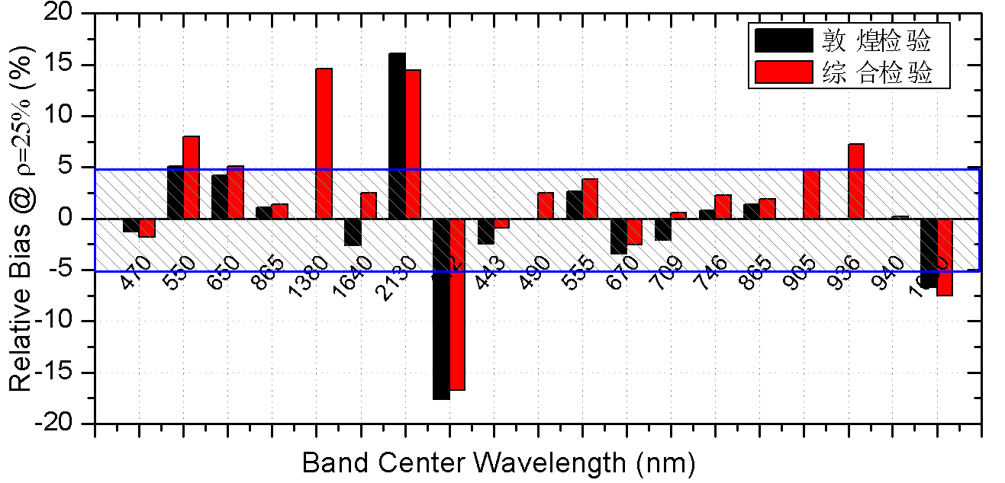
SRB Validation Results From CRCS
On-orbit validation based on Integrated calibration (VC) and In situ CRCS using Dunhuang site
band | Center Spectral nm | Integrated-VC % | Dunhuang Insitu VC %
1 | 470 | -1.79 | -1.28
2 | 550 | 7.99 | 5.09
3 | 650 | 5.14 | 4.22
4 | 865 | 1.37 | 1.12
5 | 1380 | 14.63 | NaN
6 | 1640 | 2.47 | -2.6
7 | 2130 | 14.42 | 16.08
8 | 412 | -16.72 | -17.63
9 | 443 | -0.91 | -2.48
10 | 490 | 2.49 | -0.06
11 | 555 | 3.82 | 2.62
12 | 670 | -2.52 | -3.46
13 | 709 | 0.59 | -2.11
14 | 746 | 2.27 | 0.83
15 | 865 | 1.92 | 1.36
16 | 905 | 4.74 | NaN
17 | 936 | 7.22 | NaN
18 | 940 | 0.19 | NaN
19 | 1030 | -7.52 | -6.67
Prelaunch laboratory calibration perform well on-orbit, and the biases of most bands are within 5%. The two independent validation results show good consistency.
Dunhuang VC
Integrated VC
Validation results comparsion between integrated vicarious calibration (without insitu measurement) and Dunhuang site insitu calibration（2018.05）

Slide 17
SRB Calibration Monitoring using Moon, DCC and Multi-sites
SRB bands degradation monitoring based on Moon、DCC、Multi-sites

Slide 18
zz
670nm: ~2.7%
412nm: ~3.3%
555nm: ~2.7%
865nm: ~2.7%
1030nm: ~2.5%

Slide 19
MERSI-II SRB Cal Bias
After Correction
Bias <3% for most of MERSI-II SRB bands

Slide 20
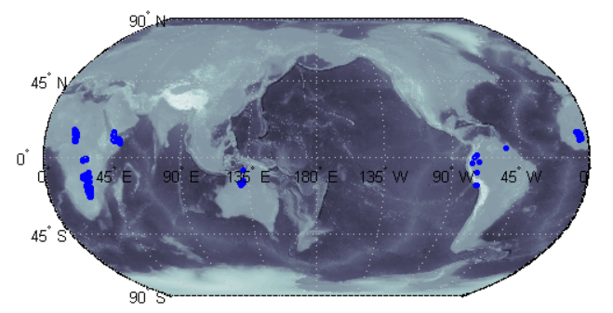
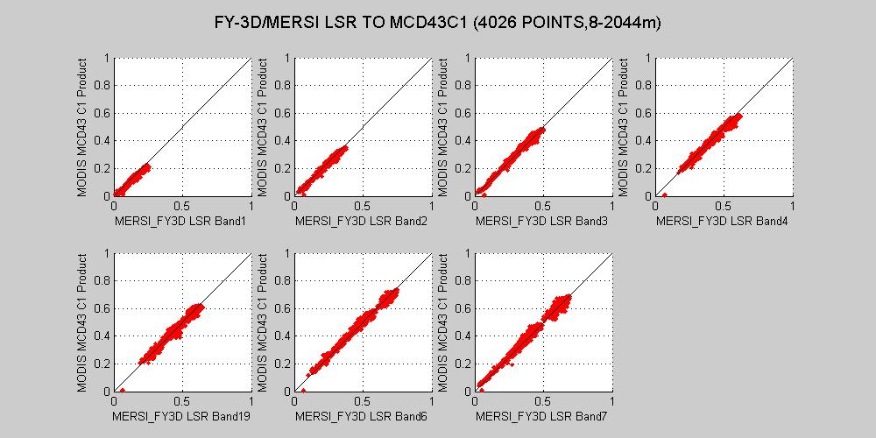
Land surface Reflectance vs MODIS within 5%
Validation Using MODIS LCD43 LSR

Slide 21
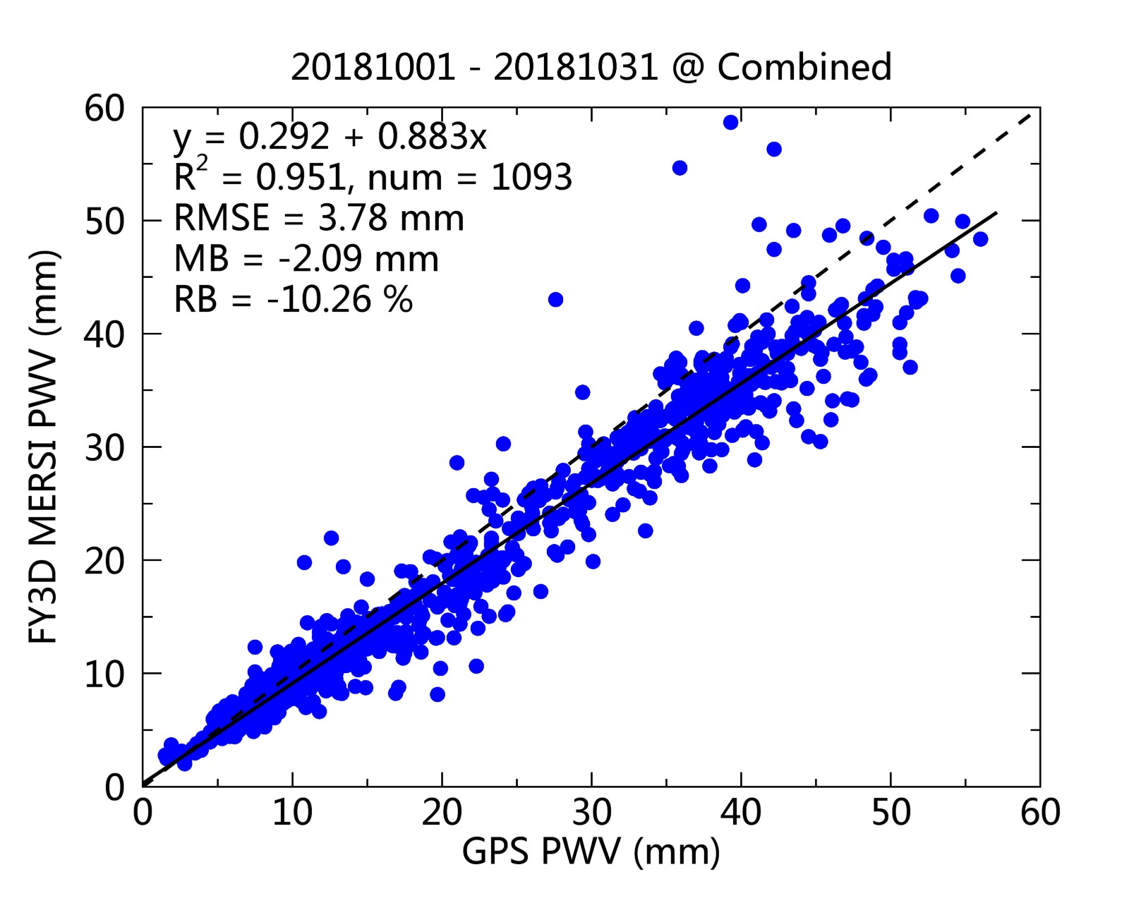
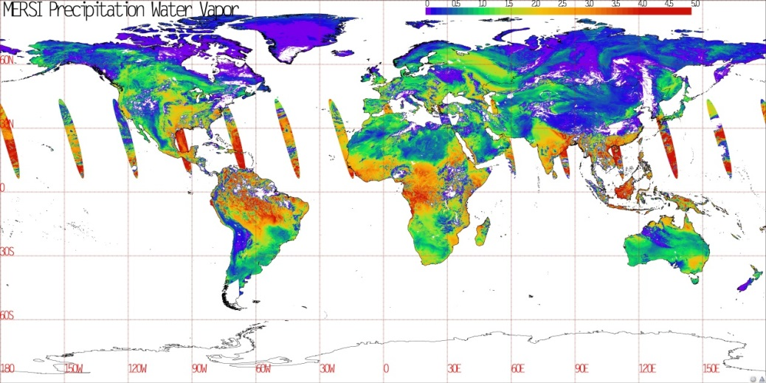
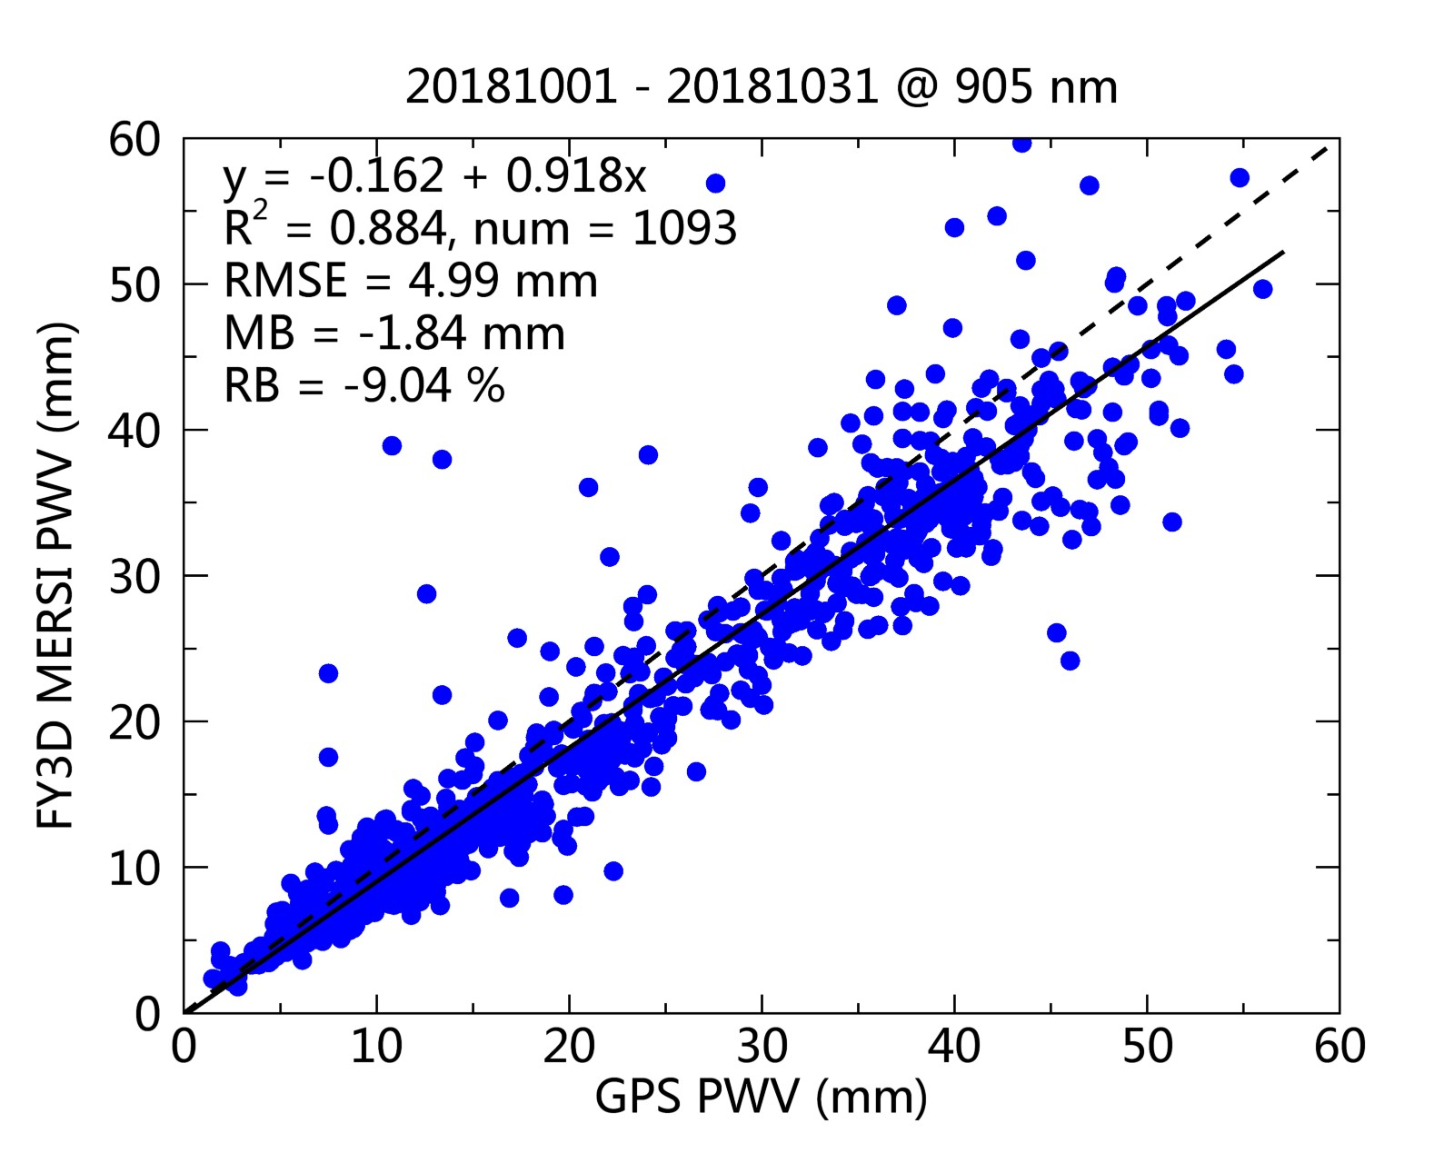
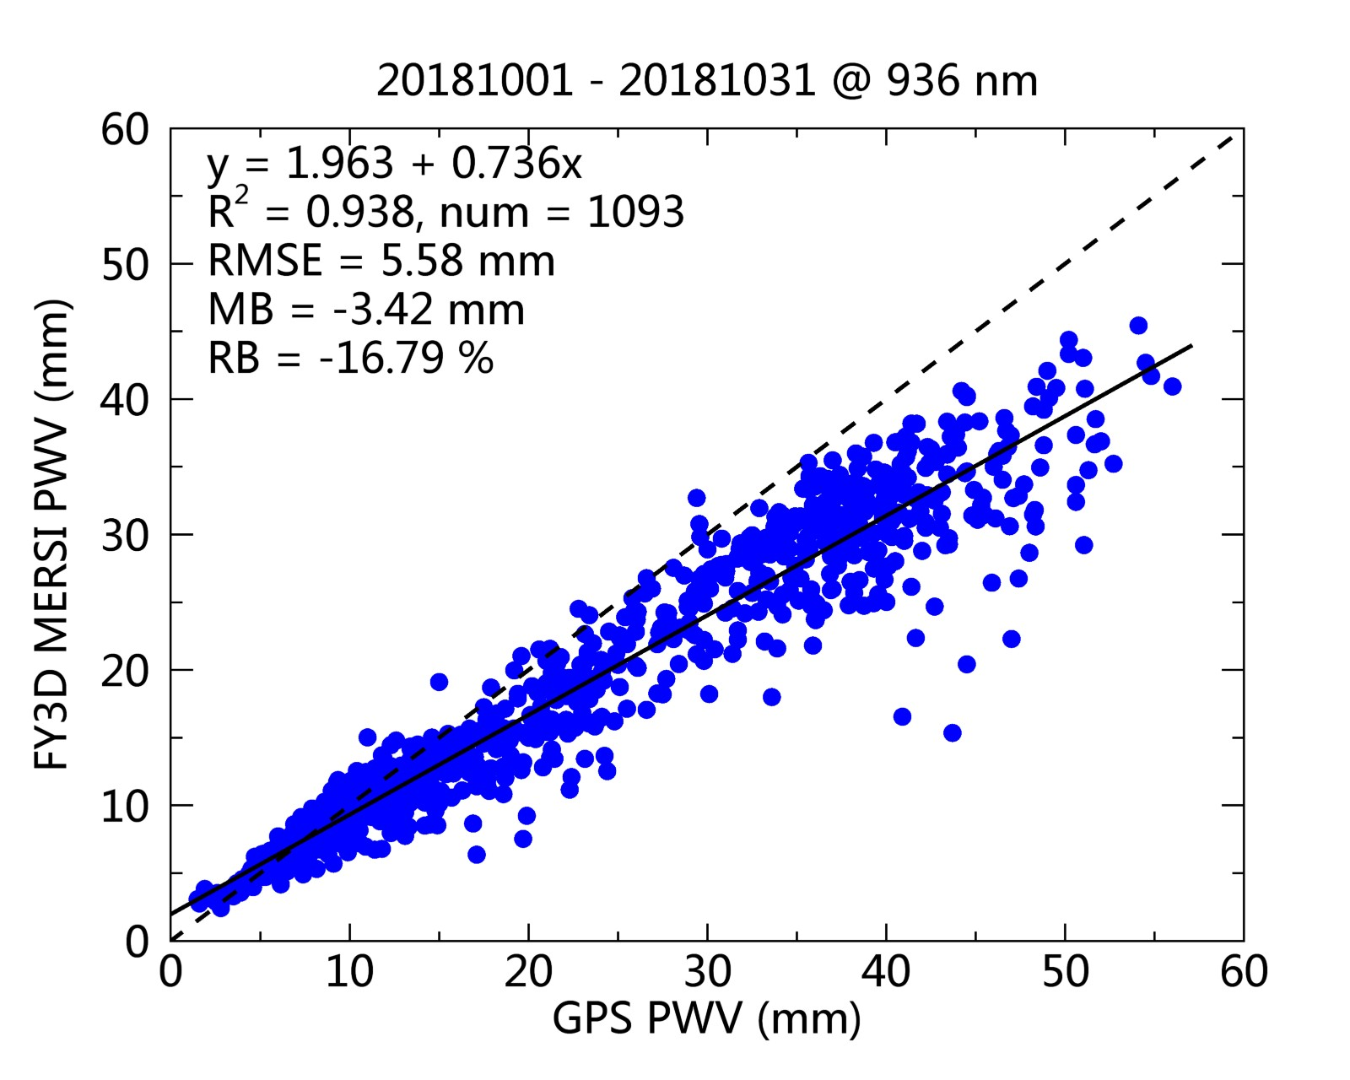
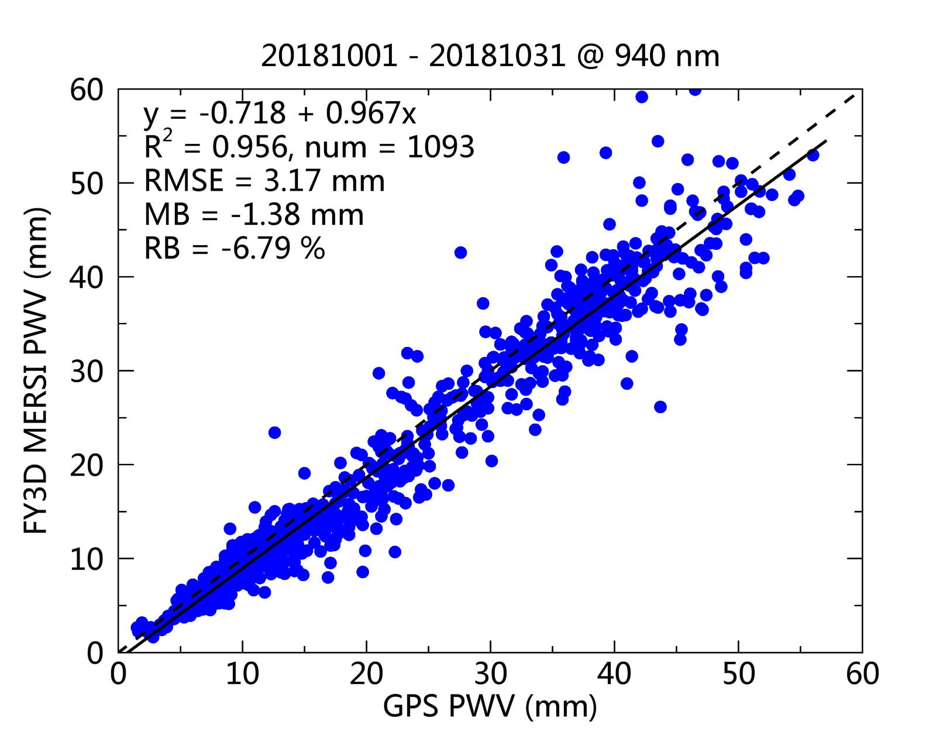
Precipitation Water Vapor(PWV) from NIR using ground-based GPS

Slide 22
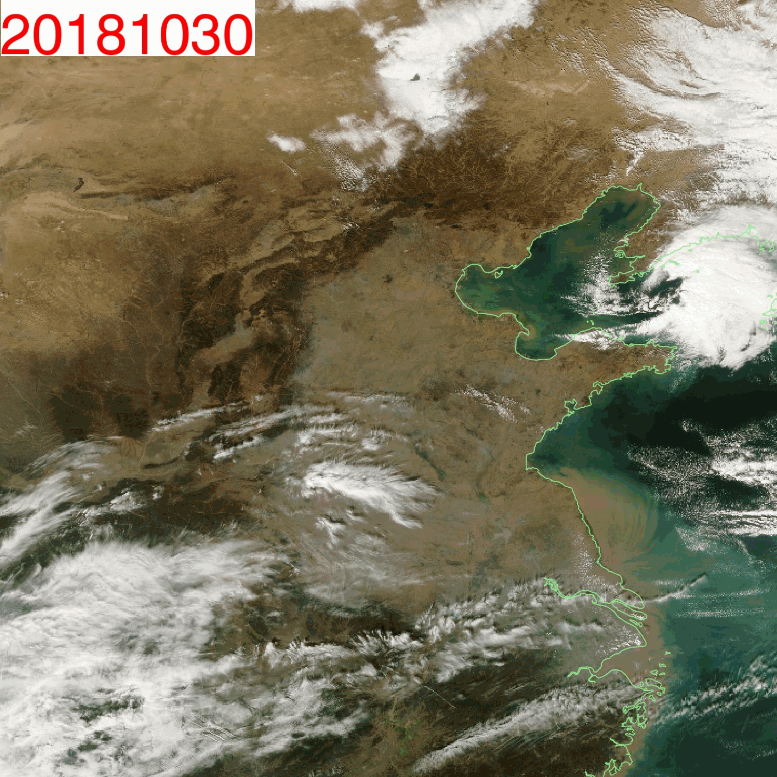
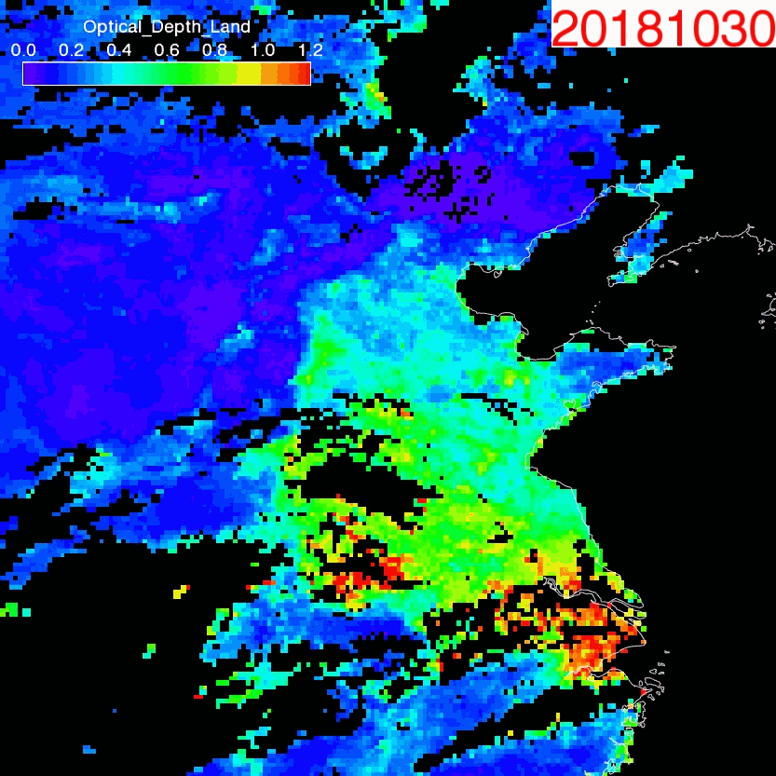
AOD from MERSI-II for monitoring the haze activities

Slide 23
HIRAS Cal/Val progress
Mar ,2018
- HIRAS infrared detectors powered on and Telemetry check
- Checks of 1st IGM, Raw Spectra, Calibrated spectra
- Initial alignment of Interferometer fixed-mirror
Apr, 2018
- Change of detector Temperature from 85Deg to 82Deg
- Fine alignment of Interferometer fixed-mirror
- Temperature cooling down of ICT
- Cold space observations
- ILS parameters tuning and NL coefficients generation
March ~ June commission test , 17 items
- NEdT evaluation, Spectral validation
- Radiance validation,Inter-pixel comparison
Aug, 2018
- commission finished
Dec, 2018
- Decontamination and turn on

Slide 24
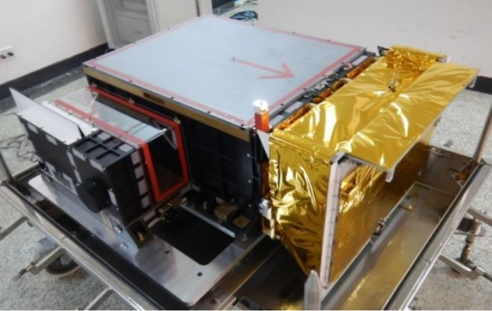
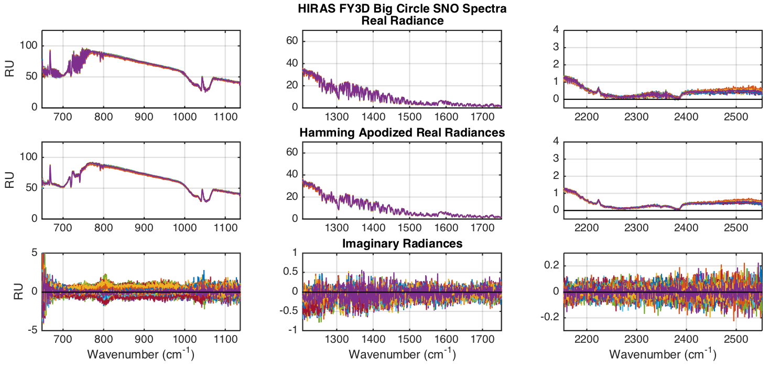
HIRAS Radiances from example SNO
32 spectra overlaid
Example of very uniform SNO shows good performance
From Hank Revercomb

Slide 25
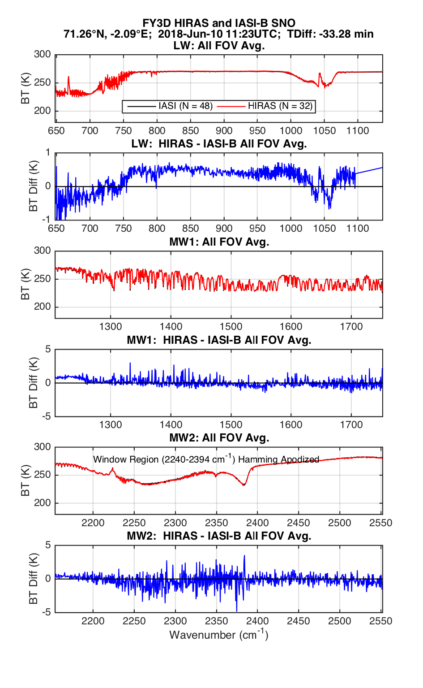
HIRAS compared to IASI-B single example SNO
Early SNO comparisons
with IASI and CrIS
are very promising
HIRAS
From Hank Revercomb

Slide 26
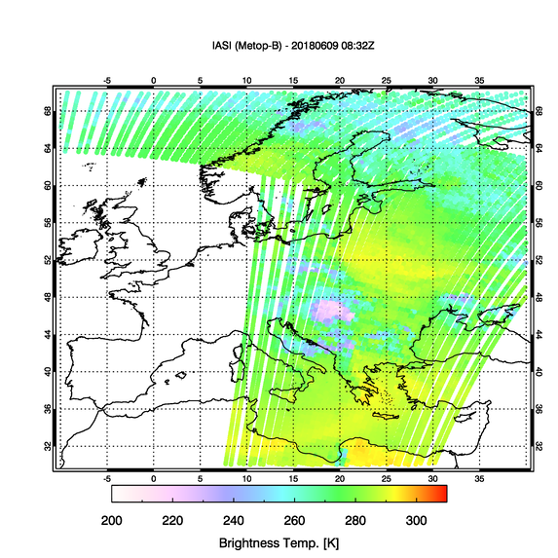
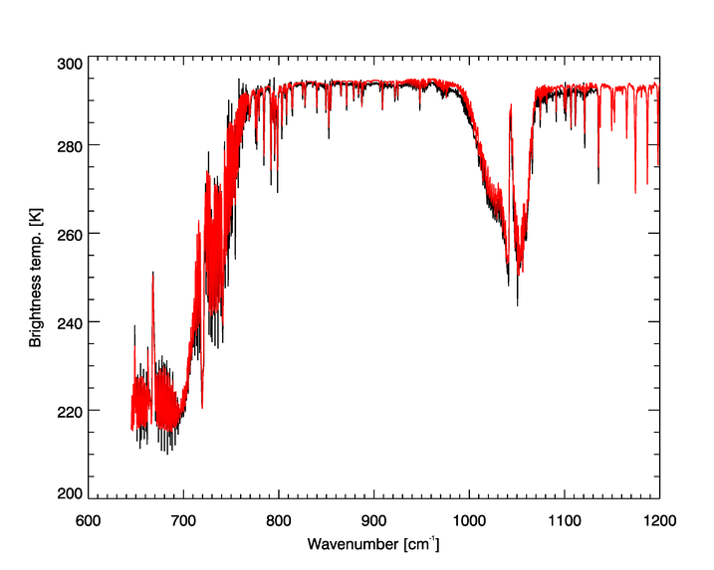
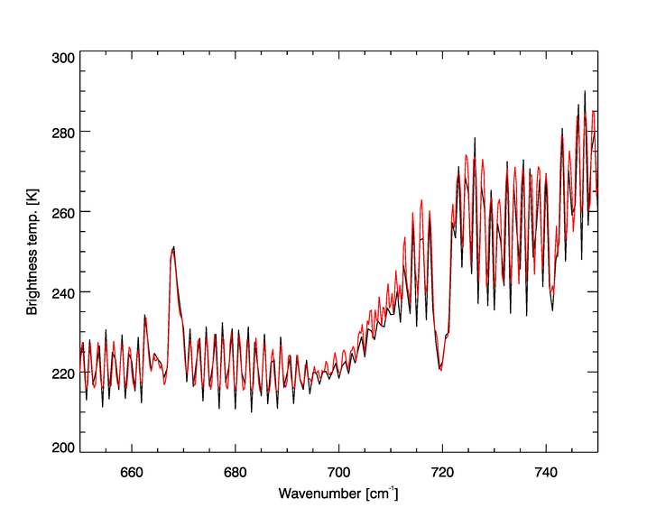
HIRAS vs IASI
A first look to HIRAS data from EUMETSAT
Courtesy of Dorothee Team
HIRAS
IASI

Slide 27


IASI/B vs. HIRAS (Antarctic)
A first look to HIRAS data from EUMETSAT
Courtesy of Dorothee Team

Slide 28


HIRAS vs. IASI/B (Antarctic)
A first look to HIRAS data from EUMETSAT
Courtesy of Dorothee Team
Difference HIRAS-IASIA - Antarctic
All scenes
200000 IASI spectra
150000 HIRAS spectra
HIRAS
IASI
0,24K

Slide 29


Spectral accuracy validation
HIRAS OBS compared with LBLRTM simulation in clear ocean condition.
Clear pixels filtering: Using MERSI cloud mask production.
MERSI-II Cloudmask
Clear pixels determined from MERSI cloud mask

Slide 30



LW band
MW band
Spectral bias monitoring in 9 months, spectral bias is in range of 5ppm for MW and SW in 9 months. There is 5~10 ppm trend in LW, after on-orbit heating it recovered.
SW band

Slide 31


HIRAS Evaluation with
GSICS LEO-LEO IR intercalibration
SNO collocation Method
Time Constrains: 10 minutes
Air Path Constrains
FOR 14-17 for CrIS
FOR 14-16 for HIRAS.
Distance constrains: 5 km
Scene uniformity
VIIRS and MERSI: std < 0.2K
Results with CrIS:
Data: 2018.04.25-2018.05.15 20 days
LW bias <0.5K，MW <0.7K；
LW bias std <0.3K，MW std 0.2~1K；
Wang et al, 2016

Slide 32

Data:2018.04.22-2018.05.26 17 days
LW bt bias <0.5K，MW bt bias < 0.7K；
LW bias std <0.5K， MW bias std in 0.5~1K，
SW window and weak absorption region <0.5K, >0.5K @absorption ；

Slide 33

HIRAS-CrIS bias monitoring
4 months of HIRAS-CrIS bias monitoring shows stable error characteristics.

Slide 34


O-B monitoring shows stable bias
O-B using Chinese ARM radiative transfer model
34

Slide 35

Inter-Comparison between HIRAS vs MERSI-II
4 bands are fully covered by HIRAS, 2 LW 1 MW, 1 SW;
2 bands in spectral gap;
HIRAS
CH25
CH24
CH23
CH22
CH21
CH20
IR Band | MERSI |  |  | HIRAS(cm-1)
 | (Cm-1) | (μm) | IFOV(m)
CH25 | 833.33 | 12.0 | 250 | 650-1135 (LW)
CH24 | 925.93 | 10.8 | 250
CH23 | 1169.59 | 8.55 | 1000
CH22 | 1388.89 | 7.2 | 1000 | 1210-1750 (MW)
CH21 | 2469.14 | 4.05 | 1000 | 2155-2550 (SW)
CH20 | 2631.58 | 3.8 | 1000
Notes:
加阴影

Slide 36

Accurate collocation Method
An accurate collocation method from GSICS is used for inter-calibration on the same platform. (Wang et al., 2013,2016).
Satellite
Accurate collocation is based on line-of-sight pointing vectors, but not the spatial location.
Computing the two sensor’s pointing vector;
Comparing the angle between pointing vectors with HIRAS’s FOV size angle;
Finding exactly which MERSI pixels are in HIRAS’s FOV.
P

Slide 37



Collocated Samples filtering of MERSI-HIRAS
MERSI-HIRAS bias changed with scene brightness temperature
Before and After scene uniformity check

Slide 38





HIRAS Geolocation Evaluation
Geolocation inconsistency was found at the beginning of commissioning.
Local Zoom-in
MERSI
MERSI-HIRAS
Radiation of the two instruments shows a significant difference in the inhomogeneous targets, especially at coastline;
Bias has no systematic error along the coastline;
Notes:
The radiation of MERSI and HIRAS shows a significant difference in the inhomogeneous targets, especially at coastline, that means the geolocations of MERSI and HIRAS are inconsistency. If we enlarge the coast line area, we found the bias has no systematic error along the coastline. The bias distribution of traditional geolocation inconsistency will show that, on one side of the coastline the bias are positive and on the other side, the bias are negative. But here is not. So the geolocation inconsistency between MERSI and HIRAS are not the traditional kind.

Slide 39




Geolocation consistency
FOV1
FOV2
Checking geolocation consistency between 4 FOVs
Orbit Direction
FOV4
FOV3
 | X | Y
FOV1 | -37 | 3
FOV2 | 32 | 0
FOV3 | 31 | 2
FOV4 | -32 | 3
Scan Direction
The FOVs maybe reverse left and right!
Low latitude, nonuniformity samples
FOR 13-17，near nadir samples
Notes:
In order to analysis this phenomenon, we need to check geolocation consistency between 4 FOVs. We check the correlation of each HIRAS FOV image and the collocated MERSI’s image. The method is, we shift the MERSI image along the scan and along the orbit direction， and after each step, we can get a RMSE. The location of minimum of RMSE coincide the geolocation inconsistency between HIRAS and MERSI.
Here we choose the near nadir low latitude and nonuniformity samples to do this work. We can see from this result that, the minimum RSME of FOV1 is negative 37 along the scan, and the FOV3 is 32. It means that the FOV maybe reverse left and right

Slide 40




Results after geolocation correction
HIRAS
MERSI
MERSI-HIRAS
before
after

Slide 41

FOVs radiometric consistency
Bias analysis: stripe
7.2μm bias at different BT
In MW, the FOV3’s bias is much higher than the others, the difference between FOV3 and the minimum bias is nearly to 0.3 K;
In SW and LW, the biases between MERSI and HIRAS in 4 FOVs are similar to each other;
FOV3
 | CH21 (SW) | CH22 (MW) | CH24 (LW) | CH25 (LW)
FOV1 | -0.160±0.170 | 0.096±0.177 | -0.402±0.253 | -0.252±0.192
FOV2 | -0.165±0.177 | 0.182±0.186 | -0.399±0.149 | -0.346±0.170
FOV3 | -0.186±0.319 | 0.389±0.312 | -0.420±0.279 | -0.258±0.236
FOV4 | -0.167±0.169 | 0.242±0.251 | -0.422±0.327 | -0.256±0.247
Non-linear feature of 4 FOVs are difference;
FOV3’s non-linearity seems more significant than others;
Notes:
The further work is still ongoing

Slide 42



HIRAS bias in different FOVs
FOV3’s bias has a little departure from other FOVs
LW
MW
SW

Slide 43


Results: Bias Angle dependence
Bias analysis: angle dependent bias
The bias at 7.2μm is increase with scan angle;
Bias at nadir is minimum, and the maximum appears at edge of scan;
All FOVs’ bias increase with scan angle;

Slide 44


Iner-Comparison between
MERSI-II and HIRAS
collaboration of intercalibration in the different and same platform.
TEBs OBC paremeters correction use IASI and CrIS as reference
Before correction
After correction
Notes:
IASI and CrIS is used as reference for MERSI II TEBs OBC paremeters correction, and MERSI and HIRAS inter-calibration can be used for global validation based on GSICS Fine Collocation method of Sounder with Imager

Slide 45




Before correction
After correction

Slide 46



Contamination Issue
Gas emission and condensation from inside instrument glues
Daily monitoring of ISRF degrading as compared with 2018.04.21.

Slide 47



Signal Response and NEDT Degradation
NEdT after HIRAS post-launch Cal/Val test (2018.04.25).
NEdT after HIRAS 8-months operation (2018.12.20).
Daily monitoring of ISRF degrading at typical spectral absorbing positions (LWIR: 801.2cm⁻¹, MWIR: 1259.29cm⁻¹, SWIR:2339.2cm⁻¹).

Slide 48
MERSI-II/HIRAS Cal/Val Continuity
GSICS SNO or SNOx monitoring using reference instruments (IASI, CrIS, MODIS,VIIRS) and Intercomparison with EUMETSAT partner sensors including Sentinel 3 OLCI/+SLSTR, GOME-2.
Operational Instrument Performance Monitoring for long term based on OBC complete telemetry parameters
MERSI-II Calibration trend monitoring will be kept going using PICS sites, DCC, moon and ground-based automatic measurements at Dunhuang site. Integrated calibration system will be established which combines earth targets, moon, DCC and RT simulation.
The improvement of HIRAS nonlinear correction and polarization upgrade are kept on going.
HIRAS contamination is kept on monitoring and Its decontamination will be done every six months.

Slide 49



HIRAS Improvement from FY-3D
to FY-3E Early Morning orbit
FY-3D
FY-3E
designed & built at Shanghai Institute of Technical Physics
Band | Spectral Range (cm⁻¹) | Spectral Resolution (cm⁻¹) | Sensitivity (NEΔT@280K) |  |  | Num of Channels
 |  |  | FY-3D | FY-3E
LWIR | 650～1136 （15.38μm～8.8 μm） | 0.625 | 0.15(Expectation) 0.4K(Requirement) | 650 ～667 cm⁻¹ | 0.8K | 778
 |  |  |  | 667～689 cm⁻¹ | 0.4K
 |  |  |  | 689～1000 cm⁻¹ | 0.2K
 |  |  |  | 1000～1136 cm⁻¹ | 0.4K
MWIR1 | 1210～1750 （8.26μm～5.71 μm） | 1.25 | 0.1(Expectation) 0.7K(Requirement) | 1210～1538 cm⁻¹ | 0.2K | 433
 |  |  |  | 1538～1750 cm⁻¹ | 0.3K
MWIR2 | 2155～2550 （4.64μm～3.92 μm） | 2.5 | 0.3(Expectation) 1.2K(Requirement) | 2155～2300 cm⁻¹ | 0.3 | 159
 |  |  |  | 2300～2550 cm⁻¹ | 0.5

Slide 50




Global Image Mosaic of MERSI-II Clear Sky images
Courtesy of Yanting Wang

Slide 51

Global Image Mosaic of MERSI-II Clear Sky images
D星看美丽星球
Courtesy of Yanting Wang

Slide 52



美丽星球
Global Image Mosaic
of MERSI-II Clear Sky images
Courtesy of Yanting Wang

Slide 53



North American Image Mosaic
of MERSI-II Clear Sky images
Courtesy of Yanting Wang
风云三号晴空数据集效果展示

Slide 54

Email：huxq@cma.cn
Tel: 68407463
Cell phone: 17710267179
National Satellite Meteorological Center, CMA
Thanks！

